Slide 1
Midwest Pipeline Corridor
(Trillion Btus Per Year)
1,019
Pacific
1
547
West North
Central
New
England
East
North
Central
Middle
Atlantic
Mountain 1
657
1,898
1,462
Pacific
2
1,314
3,346
736
South
Atlantic
656
East
South
Central
Mountain 2
West South
Central
2,603
6,117
Source: GRI 1999 GRI Baseline Projection

Slide 2
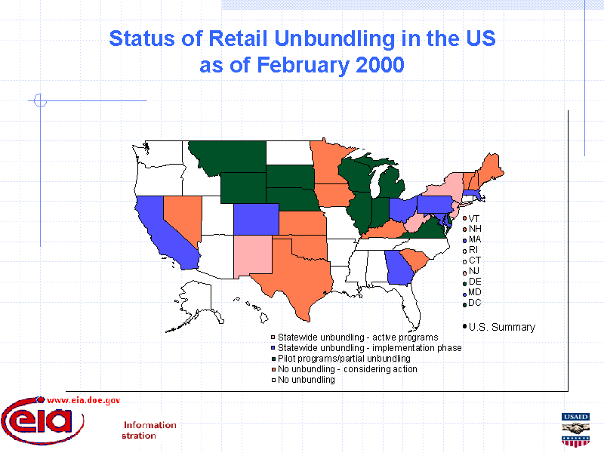

Slide 3
Strategic Market Area Hub
6.4 TCF Market
Sable Island
East Canada
Dawn
Malin
Wisconsin
New York
Michigan
Chicago
Indiana
Ohio
San Juan
SoCal
Permian
Mobile Bay
Henry Hub

Slide 4
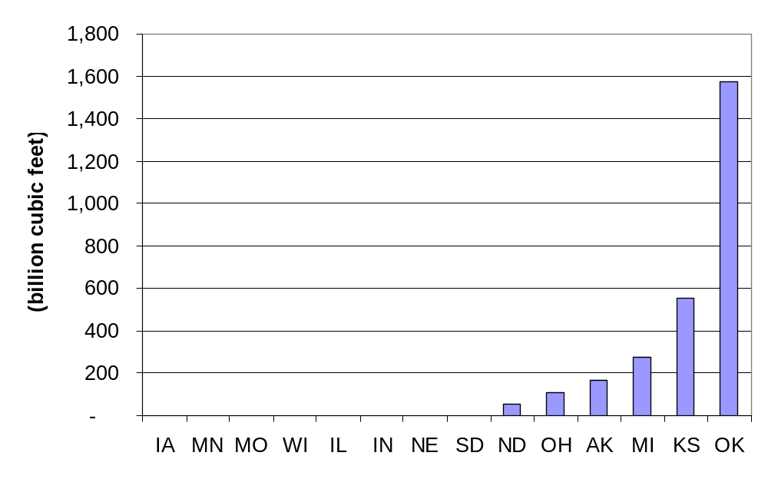
Natural Gas Marketed Production by State, 1999
Midwest region represents 14.0% (2.7 TCF) of total U.S. marketed production
Source: EIA Natural Gas Annual 1999

Slide 5
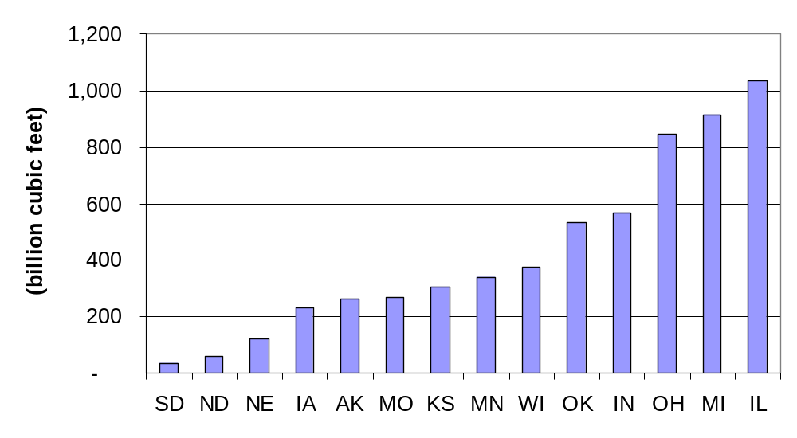
Natural Gas Consumption by State, 1999
Midwest region represents 26.9% (5.9 TCF) of total U.S. consumption
Source: EIA Natural Gas Annual 1999

Slide 6
Central Region Origination
West North Central
East North Central
>180 Customers
432 BCF
Annual Consumption
>200 Customers
2.11 TCF
Annual Consumption
>400 Customers
620 BCF
Annual Consumption
>300 Customers
1.41 TCF
Annual Consumption
>250 Customers
1.41 TCF
Annual Consumption
>800 Customers
1.09 TCF
Annual Consumption

Slide 7
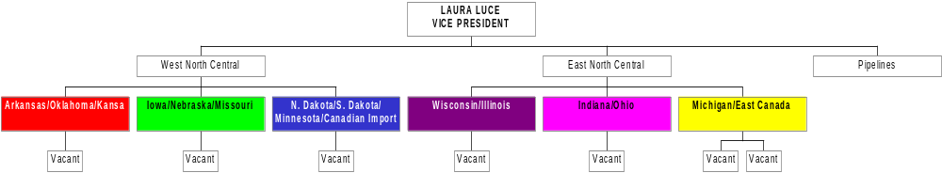
Central Region Origination
Chris Meyer
Staff Commercial
Current – Sylvia Pollan, Deirdre McCaffrey, Russell Murrell, Chris Meyer
Vacant – 4
Staff Support
Vacant – 3

Slide 8
Midwest
Geographic Region consists of 14 States & 1 Canadian Province
  West North Central - North Dakota, South Dakota, Nebraska, Kansas, Oklahoma, Minnesota, Iowa, Missouri, Arkansas
  East North Central - Wisconsin, Illinois, Michigan, Indiana, Ohio, East Canada
Over 2000 Gas Commodity Customers
Customers Represent: Utilities, Industrials, Producers, Municipals, Gas Fired Generators, Retail Providers
  Midwest Region Represents 2.7 tcf of total Marketed Production (14.0%)
  Midwest Region represents 5.9 tcf of total Consumption (26.9%)

Slide 9
Midwest Customer Base
> 100 BCF/year | 29 Customers | 20 Individual Holding Companies or Owners
15 to 100 BCF/year | 47 Customers | 40 Individual Holding Companies or Owners
1 to 15 BCF/year | 226 Customers | 219 Individual Holding Companies or Owners
400,000 to 1BCF/year | 490 Customers | 463 Individual Holding Companies or Owners
0 to 400,000 | 1531 Customers (75% Municipals/Co-ops) | 1511 Individual Holding Companies or Owners
Largest 6
Nicor Gas – Illinois
Peoples Gas - Illinois
NIPSCO – Indiana
Consumers Energy – Michigan
Michcon – Michigan
East Ohio Gas – Ohio
Represent > 2.5 TCF in Market of 5.9 TCF

Slide 10
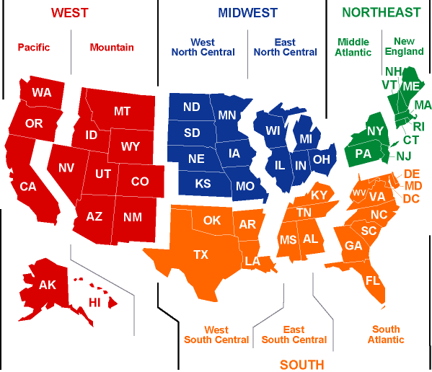
Proposed Midwest Coverage Region
OK
AR

Slide 11
Origination Customer Coverage
Midwest Divided into Two Regions
  West North Central
    Import (Canadian) Transmission Corridor
    Producer weighted (Oklahoma/Kansas)
    Municipal Environment
    Strategic area for upstream shortages into Northern Border and NNG
  East North Central
    Significant consumption market area
    Corridor to the North East
    Dramatically changing supply/market dynamic due to infra-structure
    Gas fired generation will test hourly limits of current infra-structure
    Strategic focus for a Market area Hub
    Molecular network connecting Canada, Chicago, and Michigan to the Northeast

Slide 12
Origination Customer Coverage (Cont.)
Customer Coverage
  Regional Focus
    West North Central
    East North Central
  Business Unit by States
    Ownership of all gas commodity coverage transactions
    Strategy development and implementation
    Macro/Micro business Analysis
    Develops connected platform market to customer, customer to environment, environment to intra-state infrastructure, state to region, and region to North America.
    Information platform benefits trading, customer strategy formulation and overall ENA business.
  State Team led by Originator
    Alignment with Trading Desk
    Focused ownership of Market Dynamic-Cause and Effect
    Market Fundamentals vs. technical analysis
  Teams own responsibility for P/L, customer and product development
    Aggregate and Leverage to Customer Environment:
    Trading, Origination, Regulatory, Transportation and Structuring

Slide 13
Competitive Analysis
Regulatory Fundamental Research
NEED:
Comprehensive fundamental research providing regulatory market framework
Creates & Supports
      Formulation of New Gas Commodity Business Model
        Potential to implement with strategic customers
      Platform for:
        Trading Information
        Strategy Development
      Regulatory Solutions for Customers

Slide 14
Competitive Analysis
Regulatory Fundamental Research (Cont.)
All incentive mechanisms or performance based ratemaking either for gas or electric utilities in U.S.
        Approved
        Pending
        Denied
All unbundling plans for gas or electric utilities in U.S.
        Approved
        Pending
        Denied
All unbundling or incentive plans for monopoly utility companies (Communications, Energy, Cable, etc.) that required commission or legislative approval in:
        Illinois
        Mid-West
        U.S.

Slide 15
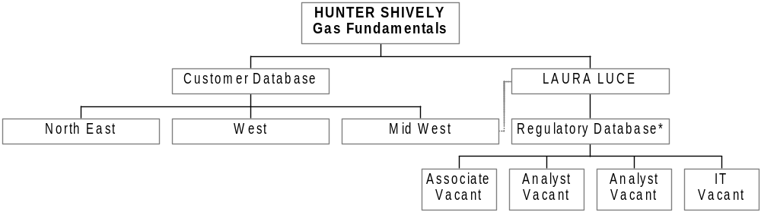
Competitive Analysis
Regulatory Fundamental Research (Cont.)
*6 Month to 1 year
Project Based in Chicago

Slide 16

enovate
Wholesale joint venture with Peoples Energy specific to the Chicago market providing natural gas products and services
Hub Products and Service exclusive arrangement for service territories of Peoples Gas, North Shore Gas, Cilco, Nicor Gas, Illinois Power and Nipsco.
Revunue sharing 50% Enron / 50% Peoples Energy

Slide 17
enovate
enovate business segments consist of:
Wholesale Marketing Trading
      Hub Market Based
      Transport Products/Services EOL
      Utility Intra-Day
        Peoples Gas Parking
        North Shore Hub
        Lending
Strategic Initiatives Asset Growth
      PEC Asset Acquisition
        Storage Monetization Asset Investment
        Base Rate Products Contractual Rights
      Incentive Mechanism
      Unbundling Strategies
      Fundamental information flow

Slide 18
Competitive Analysis Groups
Market Based Fundamental Support
Chicago Portal
Market Area Newsletter
      Sweeps pipelines – ofo’s, scheduled work, etc.
      Chicago weather today and forecast
      Basis view
      Fundamental physical predictions
      Market News
      Sweeps newswires
      Storage Report/Analysis
Provides
      Market eyes
      One Stop
      Ability to get return customer traction
      Have dialogue with Customer Groups

Slide 19
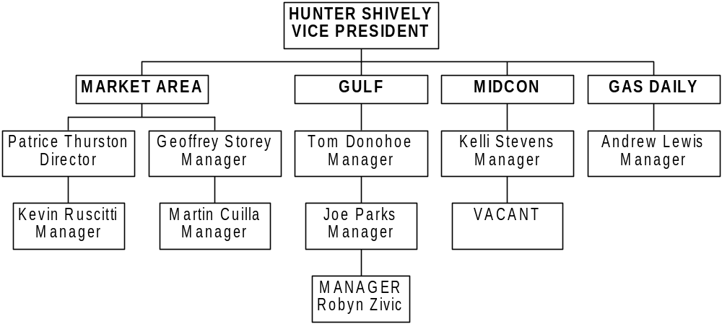
Enron North America – Central Desk

Slide 20
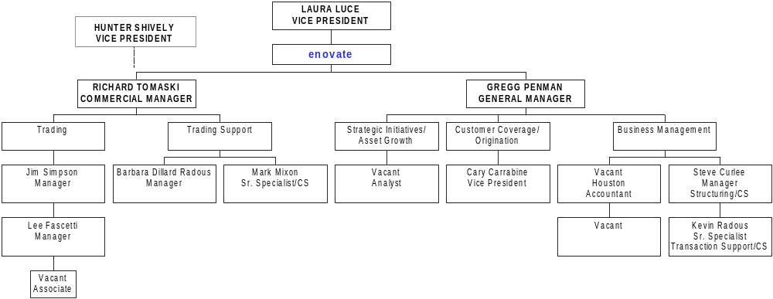
enovate - Chicago
Houston
Structuring
Houston
Economics/
Risk Control
CS: Commercial Staff

Slide 21
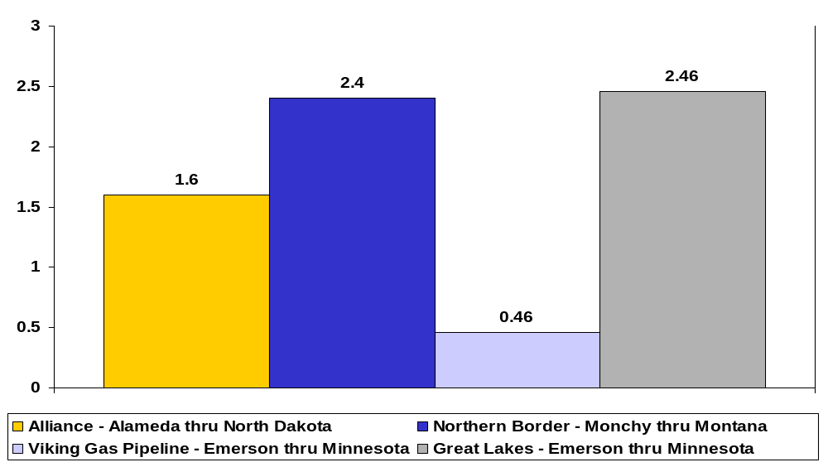
Canadian Volumes Import Capacity by Pipeline Point
(MMBtu/d)

Slide 22
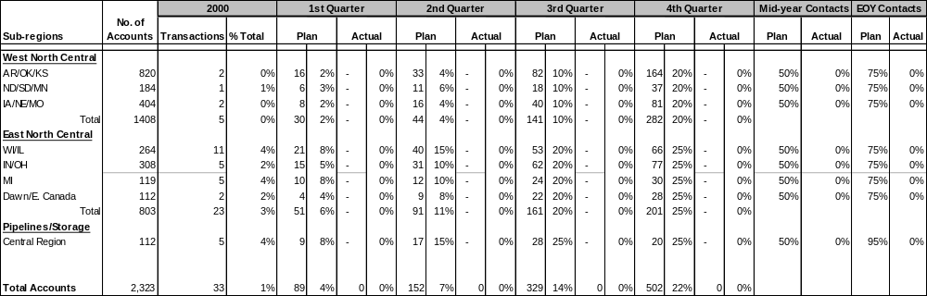
Coverage Metrics – Coverage Year 2001
*** Percentages are calculated as a percent of the total number of accounts

